Slide 1
LESSON 4.1
Sigma & Pi Bonds and Delocalization

Slide 2
LESSON GOALS
I can predict whether sigma (σ) or pi (π) bonds are formed from the linear combination of atomic orbitals
I can explain the bonding in molecules and ions using the concepts of resonance and delocalization

Slide 3
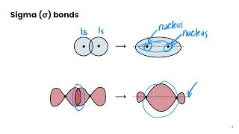
TASK 1: LEARN (MUST DO)
Individually or with a partner:
Watch the sigma and pi bonds video
Complete the appropriate section of the guided note

Slide 4
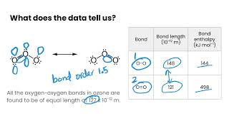
TASK 2: LEARN (MUST DO)
Individually or with a partner:
Watch the delocalization video
Complete the appropriate section of the guided note

Slide 5
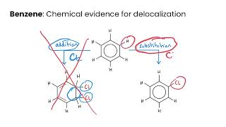
TASK 3: LEARN (MUST DO)
Individually or with a partner:
Watch the benzene and resonance video
Complete the appropriate section of the guided note
Don’t stress too much about the chemical evidence here - we will revisit this topic again when we cover organic chemistry later in the course

Slide 6
TASK 4: PRACTICE
Individually or with a partner:
Complete the sigma & pi bonds practice (answers included)
Note: There are must do, should do, and aspire to do questions included in this practice!

Slide 7
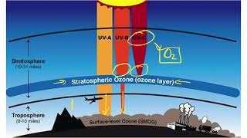
TASK 5: LEARN (ASPIRE TO DO)
Individually or with a partner:
Watch the catalysis of ozone depletion video
You do not need to know all the reactions here! The application of resonance in ozone is what’s important and might pop up on IB exams.

Slide 8
TASK 6: MASTERY CHECK (MUST DO)
Individually:
Complete the sigma & pi bonds and delocalization mastery check (see me when you are ready!)

